Slide 1
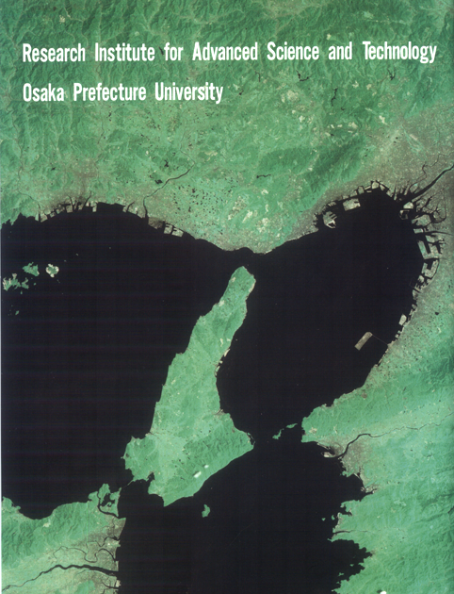
View from the satellite “Landsat”
Notes:
I am very grateful to Professor Chen Wenxiu for inviting me here and giving me an opportunity to give a talk to you.
First I would like briefly to introduce you to the institute to which I belong. This figure shows a view from the satellite named Landsat. The green and brown areas are lands, and the black area is the sea. The island seen in the middle is Awaji Island, where the seismic center of the big Hanshin earthquake in 1995 was located.
The brown area on the upper right is the city of Osaka, and our Osaka Prefecture University is located just outside this picture. The rectangular island is the man-made island of the Kansai Airport.

Slide 2
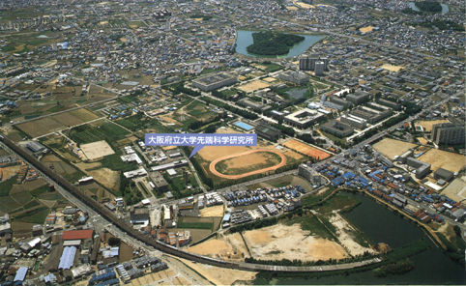
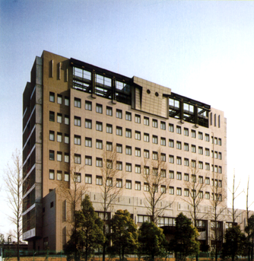
View around the campus of Osaka Pref. Univ.
The main building of RIAST
Notes:
The upper photograph shows a view around the campus of our university. The campus lies in the middle of this photograph.
The green hill surrounded by a pond is one of many remains of the ancient tombs of powerful families.
The lower photograph shows the main building of our institute.

Slide 3
Organization of RIAST
Departments: Fundamental Science Advanced Materials Science Applied Bioscience
Research Centers: Radiation Radioisotopes Bioresources Each of the three departments have 6 divisions. Each of the first two centers has 3 divisions. The third center has 4 divisions.
Notes:
Our institute consists of three departments and three research centers.
In the departments, the staff is engaged in research and the education of graduate students. In the research centers the staff is engaged in research and maintenance of large facilities.
Each of the three departments has six divisions. Each of the first two research centers has three divisions, and the third research center has four divisions.
In two of the six divisions in each department and in all the divisions of Research Center for Bioresources, we have only part-time staff coming from colleges of our university and other institutions.
I belong to the Division of Radiation Physics in the Department of Fundamental Science.

Slide 4
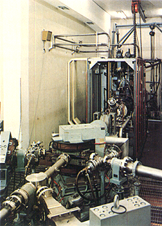
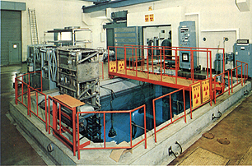
Main Radiation Facilities of RIAST
Linear Electron Accelerator
One of Co-60 Irradiation Facilities
Notes:
Our institute was built in 1959 by the name of Radiation Center of Osaka Prefecture. In 1990 it was united with the Osaka Prefecture University and changed its name to Research Institute for Advanced Science and Technology.
Presently the main research field of our institute has moved to the field of materials science, and all the radiation facilities have become quite old.
The upper photo shows the linear electron accelerator with the maximum beam energy of 18 MeV, and the lower photo shows one of Co-60 irradiation facilities.

